Slide 1
Name: K.Veerendranadh
Section: V2
Project Name: Loan Approval Analysis
Tool : Knime

Slide 2

Introduction
This is a data analytics project using machine learning in Knime Analytics Tool.
Using Supervised machine learning data is classified. Here, two machine learning algorithms are used, they are Decision tree and random forest. These two ML algorithms categorized under Supervised ML.
KNIME, the Konstanz Information Miner, is a free and open-source data analytics, reporting and integration platform. KNIME integrates various components for machine learning and data mining through its modular data pipelining "Building Blocks of Analytics" concept.

Slide 3
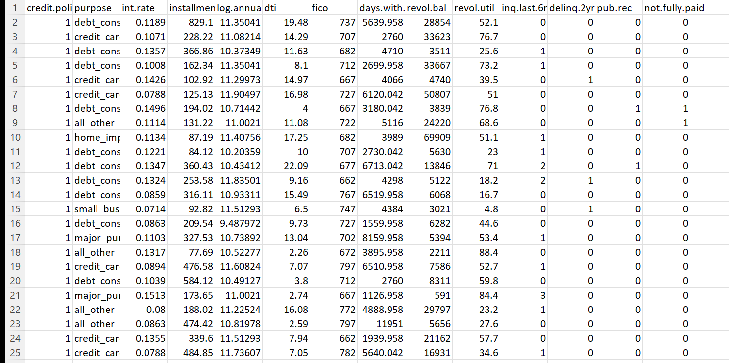
Loan Approval Analysis through Knime
Sample Data Set

Slide 4
About the data set
Attributes in this data set:
credit.policy
purpose
int.rate
installment
log.annual.inc
dti
fico
days.with.cr.line
revol.bal
revol.util
inq.last.6mths
delinq.2yrs
pub.rec
not.fully.paid
This data set consist of information about bank accounts of the individuals. “credit.policy” is the target attribute, this attribute have only two values they are either ‘0’ or ‘1’. If the value is ‘0’ then the respective candidate is not approved for loan and if it is ‘1’ then the respective candidate is approved for loan.
The remaining attributes are used for analysis by machine learning algorithms like decision tree algorithm and random forest algorithm.

Slide 5
Nodes Used
Different nodes used:
CSV reader
Partitioning
Decision Tree Learner
Random Forest Learner
Decision Tree Predictor
Random Forest Predictor
Scorer

Slide 6
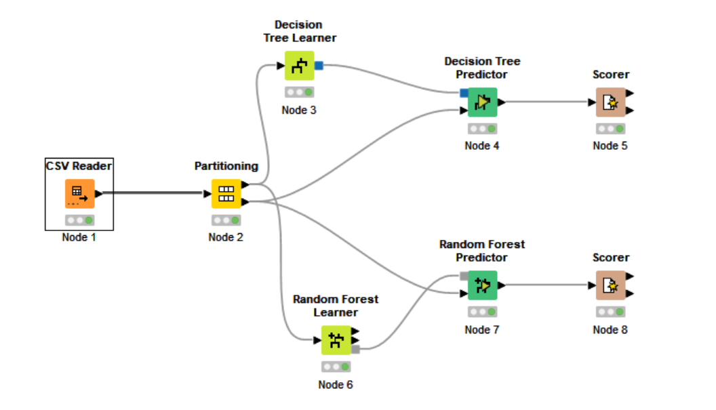
CSV Reader: Through this data is read in to knime analytivs tool.
Partitioning: Through this data is partitioned into two parts. One part consist of 80 percent of data and other part with 20 percent of data.
Decision tree Learner: This node implements supervised learning through decision tree and creates a machine learning model.
Random Forest Learner: This node implements supervised learning through Random Forest algorithm and creates a ML model.
Decision Tree Predictor: The other 20 precent of the partitioned data is fed to this predictor and then predicts the output of the data using ML model created by Decision tree learner.
Random Forest Predictor: Just like Decision Tree Predictor, this node predicts output through the ML model created by Random Forest Learner.
Scorer: This node is used to show the predictions done by predictors. Accuracy of the predictions done by predictors.

Slide 7
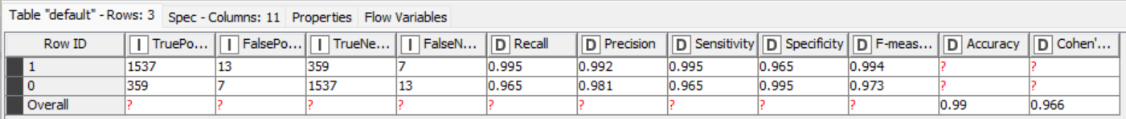
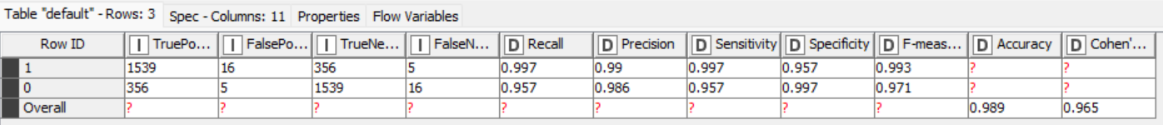
Predictions done by Decision Tree Predictor:
Predictions done by Random Forest:

Slide 8
Thank You

